Slide 1
Key findings from the HAY Harrow survey 2021
Notes:
Explain that in April and May last year over 6,000 young people in 27 primary schools, secondary schools and colleges in Harrow from Year 5 to age 18 completed the How Are You Harrow - HAY Harrow - health and wellbeing survey.

Slide 2
Questions covered ten themes
Food and travel | Exercise and sport | Home | Physical health | Mental health
Friends and family | Electronic devices and the internet | Feeling safe | School / college | The future
Notes:
Explain that the questions covered 10 themes

Slide 3
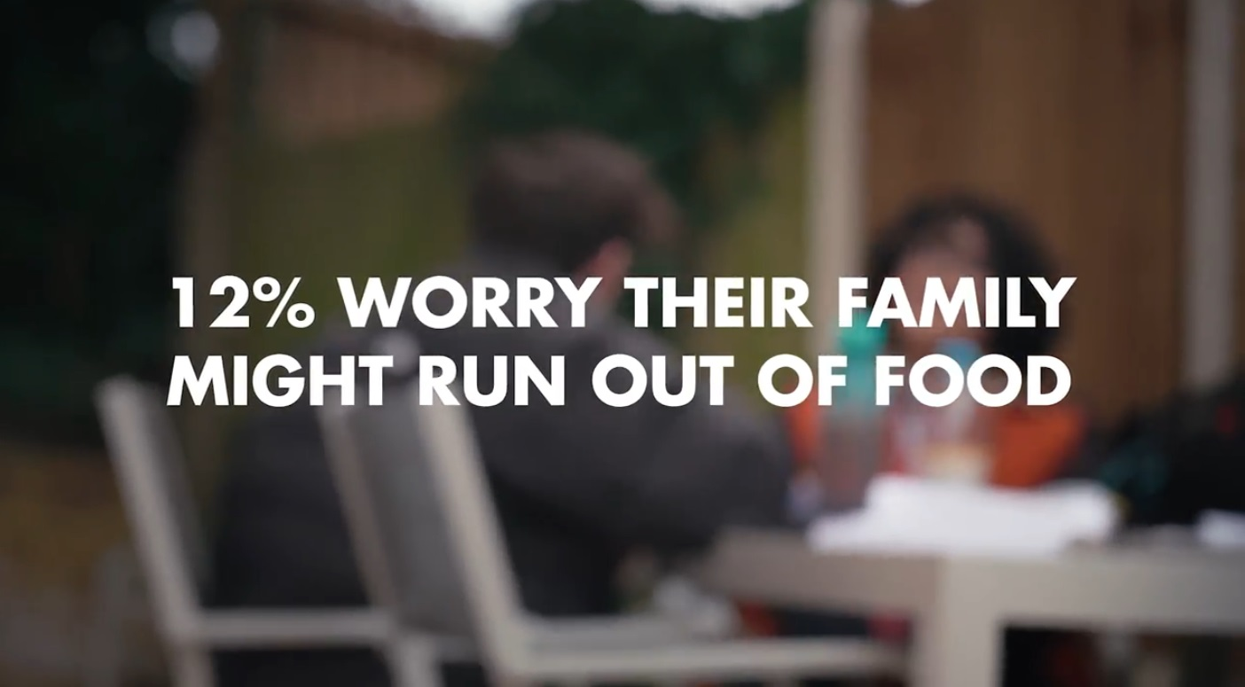
Video by young people about key findings
https://www.youtube.com/watch?v=FGUkLr1Moq0
Notes:
Explain: you’re now going to see a short video made by young people in Harrow about some of the key findings. [Lasts 1min 50 secs]
Click on picture for link.
If necessary check they understand what percentages mean.
Ask before they watch how many of the key messages in the video they can remember.
Here is the full list:
6,000 young people responded
That is 25% of all young people of 9-18 year olds in Harrow.
2% feel unsafe in their own home
12% worry their family might run out of food
4 in 10 feel unsafe in areas of Harrow
Nearly a fifth have been in a fight in the last 12 months
Nearly 50% say they haven’t gone to a gym or sports club at least once a week
65% say they sometimes or often feel anxious or depressed
Many young people in Harrow fear failure
Only 40% have found careers advice that is relevant to them
Only half are optimistic about their future

Slide 4
Harrow Council, Young Harrow Foundation, CNWL NHS Trust (school nursing)
Notes:
Explain: The survey was organised by Harrow Council, Young Harrow Foundation and Harrow School Nursing service.
Ask: Does anyone know what the council does?
It looks after the local area, cleans the streets and parks, it looks after older people, supports adults and children with disabilities, runs youth clubs and children’s centres, school nursing services, libraries, housing, and lots of other services.
Ask: Has anyone heard of Young Harrow Foundation?
They bring together 200 charities in Harrow that support children and young people.
Ask: Does anyone know what the School Nursing service does?
They provide general advice like around healthy eating as well as advice on some specific conditions like asthma.

Slide 5
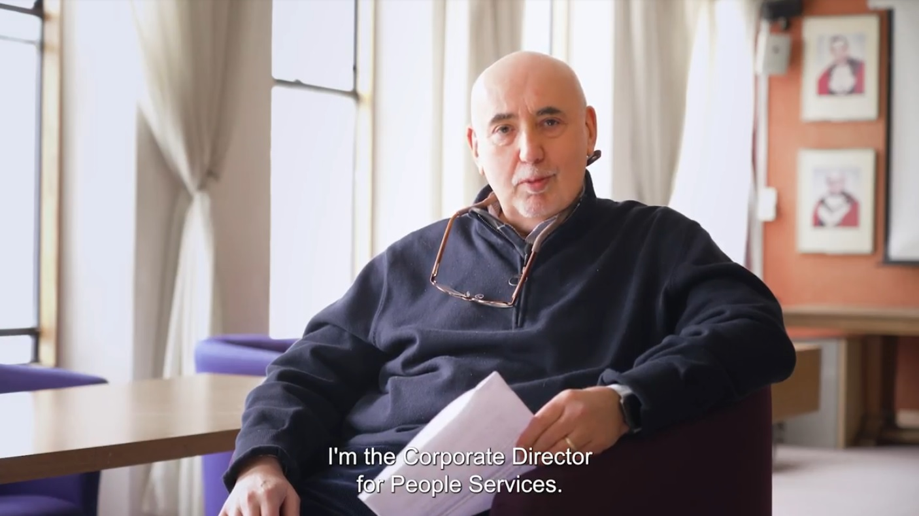
Message from key partners in response to the HAY Harrow survey
https://www.youtube.com/watch?v=Wi66FkIPR2U
Notes:
Explain: you’re now going to see a short video from some of the key managers in those organisations. [Duration: 3 min 45 secs]

Slide 6
Your reactions to this?
How do you feel about these results?
Does this match how you feel things are for young people in Harrow?
What surprised you?
Teachers: please send feedback comments from students to: HAYHarrow@youngharrow.org
Notes:
Ask if this feels true to their experience.
Ask if anything surprised them.
Send your thoughts and student feedback to HAYHarrow@youngharrow.org

Slide 7
Further help + information
If you are worried about any of the issues you have seen or want more help and support, go here:
https://youngharrowfoundation.org/young-people
(Also has links to the HAY Harrow full report)
Notes:
Please share these links and any other support sources / routes / pathways that you have in your school or college.
Curriculum links:
Ofsted inspection framework – Personal development dimensions that this assembly / class applies to:
developing and deepening pupils’ understanding of the fundamental British values of democracy, individual liberty, the rule of law and mutual respect and tolerance
promoting equality of opportunity so that all pupils can thrive together, understanding that difference is a positive, not a negative, and that individual characteristics make people unique
promoting an inclusive environment that meets the needs of all pupils, irrespective of age, disability, gender reassignment, race, religion or belief, sex or sexual orientation
Ofsted inspection framework – Spiritual, moral, social and cultural development dimensions that this assembly / class applies to:
ability to be reflective about their own beliefs (religious or otherwise) and perspective on life
knowledge of, and respect for, different people’s faiths, feelings and values
interest in investigating and offering reasoned views about moral and ethical issues and ability to understand and appreciate the viewpoints of others on these issues
ability to recognise, and value, the things we share in common across cultural, religious, ethnic and socio-economic communities
Prevent Strategy: HM Government (2007 - present)
5.13 Schools should promote open & respectful dialogue
5.17 Use spaces for voters to discuss openly issues that concern them, including exploring their own identities & how these relate to the diversity of the society in which they live
Promoting fundamental British Values: November 2014
6.5 Voters should accept that other people having different faiths or beliefs to oneself (or having none) should be accepted and tolerated, not discriminated against
UNCRC: UNICEF
Art 29 “Your education should help you use and develop your talents and abilities. It should also help you learn to live peacefully, protect the environment and respect other people.”
UN: Sustainable Development Goals
SDG 16 Peace, Justice & Strong Institutions: “Promote peaceful and inclusive societies for sustainable development, provide access to justice for all and build effective, accountable and inclusive institutions at all levels.”

